Slide 1
java METHODS Chapter – 08

Slide 2
TOPICS
Definition
Types of methods
Static method
Exercises Programs & Tasks

Slide 3
Definition
A method is a block of statements which perform some specific operations on data.
Methods are used to perform certain actions, and they are also known as functions.
Methods are defined as member function of class.

Slide 4
Definition…
You can pass data, known as parameters (arguments), into a method.
Why use methods?
To reuse code: define the code once, and use it many times.
Methods are used to modularize the program into manageable pieces.

Slide 5
Types of Methods
In java, there are two types of methods.
Pre-defined methods
User-defined methods
1. Predefined Methods:
In Java, predefined methods are the method that is already defined in the Java class libraries is known as predefined methods.
It is also known as the standard library method or built-in method.
We can directly use these methods just by calling them in the program at any point.

Slide 6
Types of Methods
1. Predefined Methods:
Each and every predefined method is defined inside a class. Such as print() method is defined in the java.io.PrintStream class.
It prints the statement that we write inside the method. For example, print("Java"), it prints Java on the console.
Let's see an example of the predefined method of Math class

Slide 7
Types of Methods
Predefined Methods:
In the above example, we have used three predefined methods main(), print(), and max().
We have used these methods directly without declaration because they are predefined.
The print() method is a method of PrintStream class that prints the result on the console.
The max() method is a method of the Math class that returns the greater of two numbers.

Slide 8
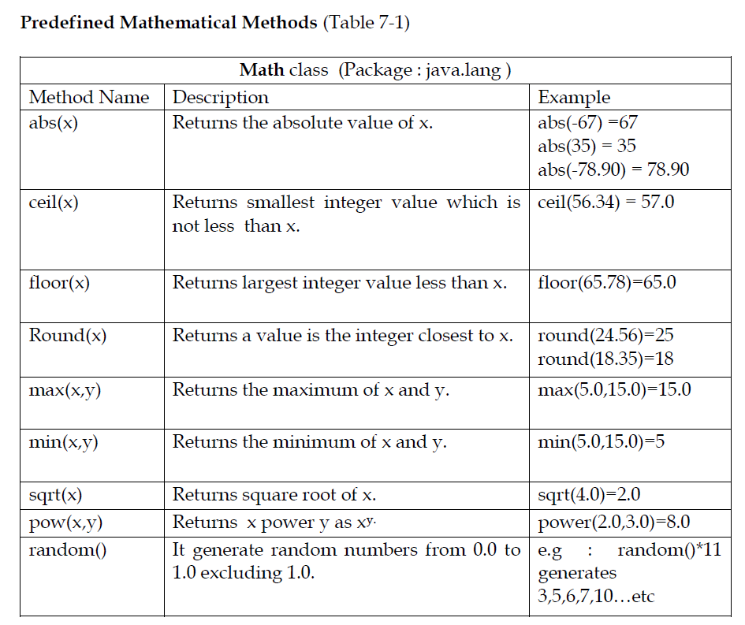
Predefined Methods:
$$\sqrt{4.0}$$
$$2^{3}$$

Slide 9
Predefined Methods: Exercise
1. Determine the value of each of the following expression
i. Math.abs(-4)
ii. Math.abs(10.8)
iii. Math.pow(3,5)
iv. Math.sqrt(25.0)
v. Math.floor(28.95)
vi. Math.ceil(35.2)
vii. Math.round(45.5)
vii. Math.round(45.4)
2. Using the method described in table 7-1, write each of the following as
a java expression.
i. ${2.0}^{5.2}$ -- > Math.pow(2.0,5.2)
ii. $\sqrt{a^{5}+b^{7}}$ → Math.sqrt(Math.pow(a,5) + Math.pow(b,7))
iii. $\frac{−b±\sqrt{b^{2}−4ac}}{2a}$ → d = Math.sqrt(b*b-4*a*c)
x1→ (-b + d)/2*a
x2 → (-b – d)/2*a

Slide 10
Predefined Methods: String class methods
Method | Description | Return type
charAt() | Returns the character at the specified index (position) | char
compareTo() | Compares two strings lexicographically | int
compareToIgnoreCase() | Compares two strings lexicographically, ignoring case differences | int
concat() | Appends a string to the end of another string | String
contains() | Checks whether a string contains a sequence of characters | boolean
endsWith() | Checks whether a string ends with the specified character(s) | boolean
equals() | Compares two strings. Returns true if the strings are equal, and false if not | boolean
equalsIgnoreCase() | Compares two strings, ignoring case considerations | boolean

Slide 11
Predefined Methods: String class methods
Method | Description | Return type
isEmpty() | Checks whether a string is empty or not | boolean
length() | Returns the length of a specified string | int
startsWith() | Checks whether a string starts with specified characters | boolean
substring() | Extracts the characters from a string, beginning at a specified start position, and through the specified number of character | String
toLowerCase() | Converts a string to lower case letters | String
toString() | Returns the value of a String object | String
toUpperCase() | Converts a string to upper case letters | String
trim() | Removes whitespace from both ends of a string | String
valueOf() | Returns the primitive value of a String object | String

Slide 12
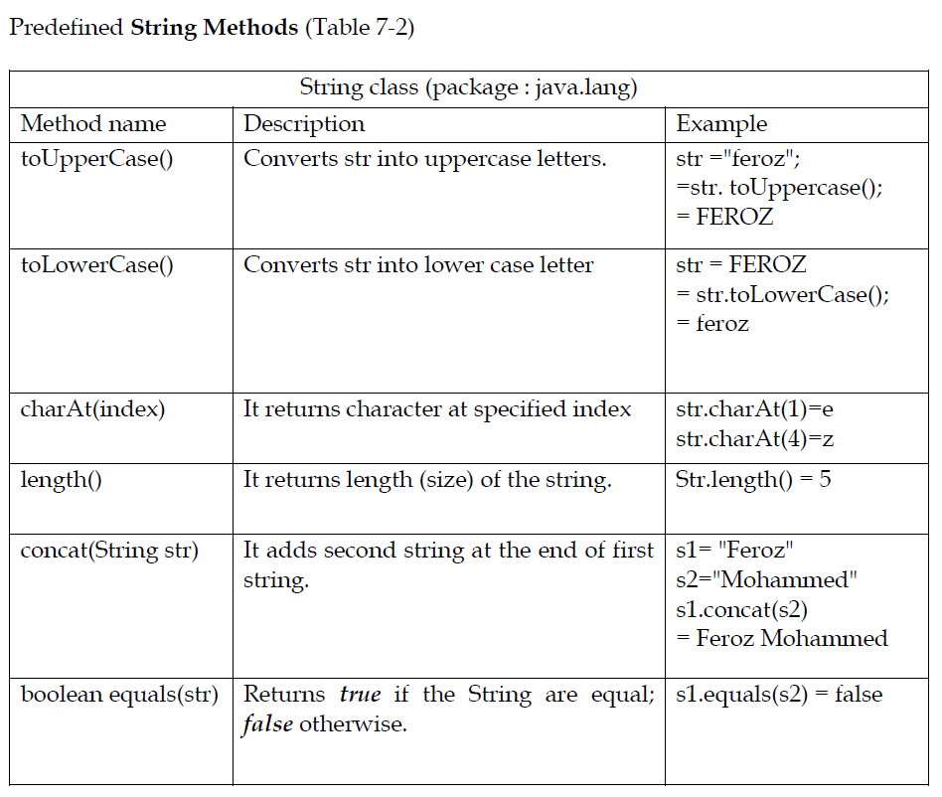
Predefined Methods: Few Examples

Slide 13
Predefined Methods: Exercise
3.Use String methods to determine below expressions or statements
Suppose s1 =“MIT” , s2=“ jic”, s3=“Information Technology” & s4 =“mit”
s2.toUpperCase() →
s3.charAt(5)→
s3.length() →
s1.concat(s2) →
s2.equals(s1) →
S1.equalsIgnoreCase(s4) →

Slide 14
Types of Methods
2. User Defined Methods : A method is designed by the user for a specific task.
Creating user defined method
Syntax
Access-specifiers return-type method-name (formal parameters list) {
Method body;
}

Slide 15
Types of Methods User Defined Methods :
Access-specifiers: It specifies the accessibility of program. (public, private, protected).
return-type: It specifies the type of data return by the method.
Method-name : Name of the method.
Formal Parameter–list: It is a list of parameters (variables). If the list is empty, then in the method call statement, empty parenthesis are still needed.
return keyword: A Method uses a return keyword to return its value. That is, it passes a value back when the method completes its task.
Syntax
return expression;
Where expression is a variable, constant value or expression, the data type of the value that expr computes should be compatible with the return-type of the method.

Slide 16
Types of Methods User Defined Methods :
Various forms of user defined methods
void methods: It is a method which do not have a return data type. i.e. it doesn’t return any value to the calling method.

Slide 17
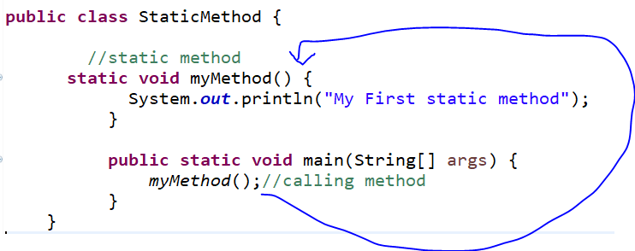
Static METHOD
Java programs that have either static or public (non static) attributes and methods. Below program is an example of static method, which can be called or accessed from main() method without creating an object.

Slide 18
Exercises
4. Identify the following methods are valid or invalid? Based on method definition.
i. public static one(int a ,int b)→Invalid
ii. public static int two(char x)→valid
iii. public static char three(int a, b) →invalid
iv. public static double fourth →invalid
v. public static float five(double ch,int d, float f) →valid
vi. public static void six(String s)→valid

Slide 19
Exercises
5. Write appropriate method heading for the following methods.
Calculate and return the sum of two decimal numbers.
Ans : public static double sum()
ii. Compute and return the average speed of a car, given the distance travelled (as in int) and traveling time (in hours and minutes of type int).
iii. Given the radius of a circle, output the area of the circle.
public static void area(double radius)
iv. Given a number, return true if the number is even; otherwise return false.
v. Given a decimal number, output the square root if the number is non
negative; otherwise, output an appropriate error message.

Slide 20
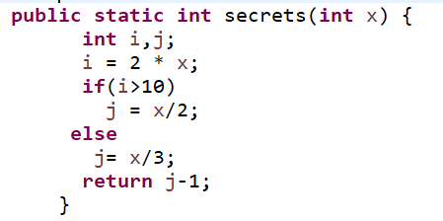
Exercises
6.What is the return value of below method secret(), when x = 10.
7. Identify the error in a given below method
public static void doubleNum(double x) {
return 2*x;
}

Slide 21
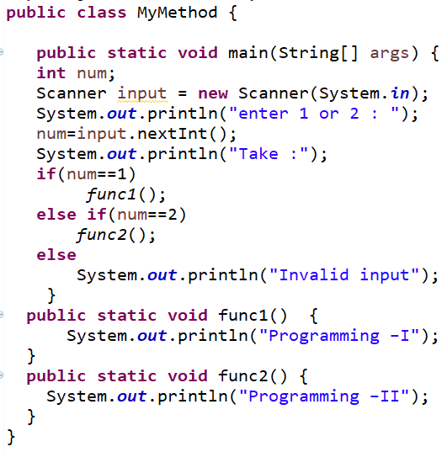
Exercises
8. Consider the following program:
i. What is the output if the input is 1?
ii. What is the output if the input is 2?
iii. What is the output if the input is 3?
iv. What is the output if the input is -1?

Slide 22
Algorithms -TASKS
Program 8.1: Write a java program that calculates the average course marks of a student as follows.
Algorithm
Create a class Average
Declare necessary variables.
b. Define a static method name total( ) which takes 3 parameters of course marks of type double , compute the total marks and print it.
c. Define another static method average( ) which computes average of marks and returns average of marks.
d. In main method, read three course marks using scanner object and call the methods total ( ), average ( ) and print the average marks.

Slide 23
PROGRAMMING - TASKS
Program 8.2: Write a java program that uses the method sqrt() of the Math class and outputs the square roots of first 10 positive integers.
Program 8.3: Write a java program that defines a static method score ()as it takes two parameters of type int say sum and testScore. The method updates the value of sum by adding the value of testScore, and then returns the updated value of sum.
Program 8.4: Write a java program that defines static method isVowel ( ) which takes one character as parameter and returns true if it's a vowel, otherwise false.

Slide 24
GOOD LUCK

