Slide 1
ARRAYS Chapter – 07

Slide 2
TOPICS
Definition
Single dimensional array
Declaration and initialization of array.
Demonstration of single dimensional arrays
Processing Arrays
Exercises programs

Slide 3
Definition
An array is a data structure to store a fixed number of elements (variables) with common name.
In Arrays , all elements has same data type.
Arrays
Single Dimension
Multi Dimension

Slide 4
Single Dimensional Array
It consists single dimension or single subscript in which all elements are arranged in a list form.
1.Declaration of array
dataType[ ] arrayName; // line 1
2. Instantiation of array
In java, an array is an object, arrayName is a reference variable.
Therefore we must instantiate the array object as.
arrayName = new dataType [arraySize]; //Line 2
Index | 0 | 1 | 2 | 3 | 4
elements | 10 | 20 | 30 | 40 | 50

Slide 5
Single Dimensional Array
We can combine the above two lines into one following statement as follows.
Syntax:
data-type[ ] arrayName = new data-type [size];
Examples:
int[ ] marks = new int [5]; // size is 5.
double[ ] price = new double[6]; // size is 6
char[ ] name = new char[10]; // size is 10

Slide 6
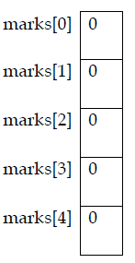
Single Dimensional Array
The statements int[ ] marks = new int [5]; declares and creates the array marks consisting of 5 elements. Each elements is of type int and stored in index form.

Slide 7
Single Dimensional Array
Accessing Array Elements
An array element is accessed by passing the index of the array.
An index is non- negative integer less than the size of the array.
The index specifies the position of the element in the array.
In java, the array index starts at 0.
arrayName[index]
In java, [ ] is an operator called the array subscripting operator.

Slide 8
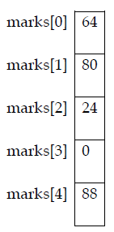
Single Dimensional Array
Initialization of array elements
We can store each element of the array in different ways as follows.
marks[0]= 64;
marks [1]= 80;
marks[2] = marks[1]-marks[0]; //evaluates as 80-64=24
marks[4]= marks[2] +marks[0];//evaluates as 24+64=88
Now the array marks look likes.

Slide 9
Single Dimensional Array
Array initialization during declaration
Like any primitive data type, an array can also be initialized with specific values when it is declared.
double[ ] price = {12.34, 45.99,78.0 ,23, 67.10};
Note
• The size of the array is determined by the number of initial values within
the braces.
• We don’t use new operator to instantiate the array object.

Slide 10
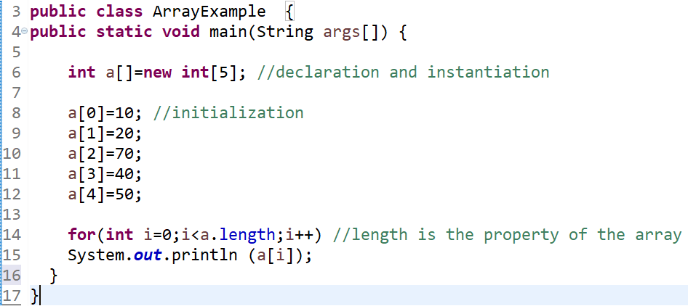
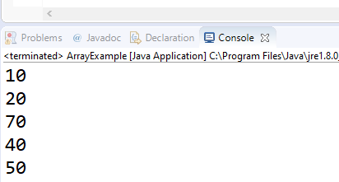
Single Dimensional Array
//Program 7.1 An example program to demonstrate sinle dimensional array

Slide 11
PROCESSING ARRAYS
Loops can be used to process arrays in several ways.
1. Initializing an array to a specific value : suppose that you want to initialize
every element of the array marks to 0. You use the following loop
for(int i=0;i<marks.length;i++)
marks[i]=0;
2. Reading data into an array: The following loop inputs data into the array
marks from the console.
for (int i=0; i<marks.length; i++)
marks[i] = input.nextInt();
3. Printing an array: The following loop outputs the elements of array marks.
for (int i=0; i<marks.length; i++)
System.out.print(marks[i] + " ");

Slide 12
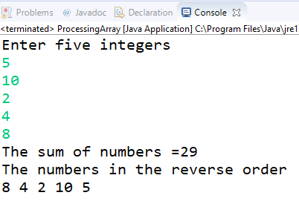
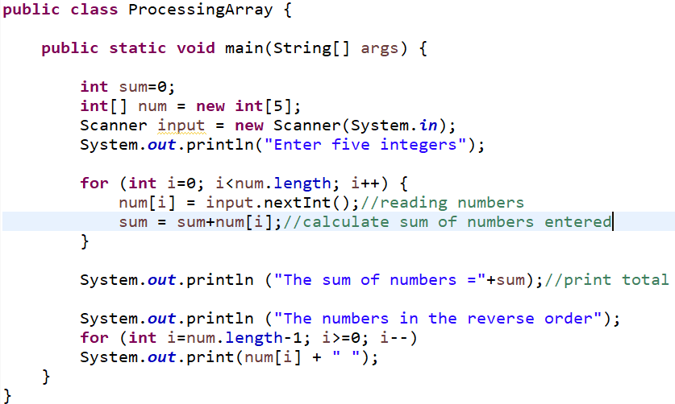
PROCESSING ARRAYS
//Program 7.2 : write a java program to read five numbers, find their sum and also print the numbers in the reverse order.

Slide 13
Multi dimensional array (2D)
COLUMNS
ROW[0] COL[0] | ROW[0] COL[1] | ROW[0] COL[2]
ROW[1] COL[0] | ROW[1] COL[1] | ROW[0] COL[2]
ROW[2] COL[0] | ROW[2] COL[1] | ROW[2] COL[2]
ROWS

Slide 14
Exercises
1. Consider the following declaration
char[] name = new char[20];
identify the following
i. The array name___________
ii. The array size__________
iii. The data type of each array elements________
iv. The range of values for the index of the array________

Slide 15
Exercises
2. Identify error(s), if any, in the following array declarations.
i. int[ ] list = new int[100];
ii. int size =100;
iii. double[] list = new double[size];
iv. int[] list = new int[10.0];
v. String[] names = new String[20];
vi. char[5] ch = { '1', ' ' ,'$, 'p','+'};

Slide 16
Exercises
3. Write java statements to define and initialize the following arrays.
i. Array heights of 10 elements of type double and initialize to the
following values 5.2, 3.7, 7.8, 45, 9.1, 8.3, 7.56, 10.0,34.2,10.0
ii. Array symbols of type char and initialize to the following values
'@','#','$','%','^','&',*','!' .
iii. Array seasons of 4 elements of type String. Initialize this array to the
following values: "fall","winter","spring","summer".

Slide 17
Exercises
4. Suppose list is an array of five elements of type int. what is stored in list after
the following java code executes?
for(i=0;i<5;i++) {
list[i] = 2 * i + 5;
if(i%2==0)
list[i] = list[i]-3;
}

Slide 18
Exercises
5. Correct the following code so that it correctly initialize and outputs the
elements of the array myList.
Scanner console = new Scanner(System.in);
int[] myList = new[10];
for(int i=1;i<=10;i++)
myList = console.nextInt();
for(int i=1;i<=10;i++)
System.out.print(myList[i] + " ");
System.out.println();

Slide 19
Tasks
Program 7.3: write a program using arrays to read 5 numbers, compute the average of numbers, and also find the number of the items greater than the average.
Program 7.4: Write a java program to find the occurrence of number 7.77 in a given list
{ 7.77,9.77,9.777,7.76,6.777,7.773,1.777,7.77 }

Slide 20
Tasks
Program 7.5: Write a java program to implement linear search.
The linear search approach compares the key element key sequentially with each element in the array. It continues to do so until the key matches an element in the array or the array is exhausted without a match being found. If a match is made, the linear search returns the index of the element in the array that matches the key. If no match is found, the search returns -1.

Slide 21
Algorithm
Program 7.6: Write a java program that reads 10 double type elements from the console and also determines the largest and smallest elements in the list.
Algorithm
a) Create a class MaxMin.
b) Declare an array myList with size 10.
c) Initialize variable smallest=myList[0] and largest=0.
d) Read the elements from the console and put into myList.
e) Print MyList elements.
f) In a loop, if the value of the array myList is greater than largest then
assign the largest to the myList value.
g) If the value of array myList is less than smallest then assign the smallest to
the myList value.
h) Print the largest and smallest elements outside the loop.

Slide 22
Good luck

