Slide 1
control structures - II Chapter – 06

Slide 2
TOPICS
Definition
Repetition/Loop control statements
Break and continue keyword
Algorithms & Example programs
Exercises & Tasks

Slide 3
Definition
Control structures allow a programmer to control the flow of program execution.
Selection/Decision/conditional control structure. (chapter -05)
Repetition/Loop control structure. (chapter -06)

Slide 4
Repetition/Loop control structure
A loop statement allows to run a statement or block of statements repeatedly for a certain number of times until the condition is true.
When the condition becomes false, then loop ends and control passed to the next statements following the loop.
The part of the loop that contains the statements to be repeated is called the loop body.

Slide 5
Repetition/Loop control structure
Java provides 3 types of loop control statements:
1. while statement
2. do-while statement &
3. for statement

Slide 6
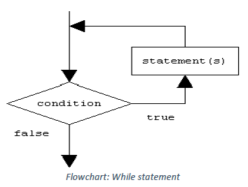
1.While Loop Statement
While loop executes the statements (body of the loop) repeatedly until the condition is true.
Once the condition becomes false the control immediately passes to the next statements available after the loop state.
Syntax
while (condition) {
//statement(s);
//Updation;
}

Slide 7
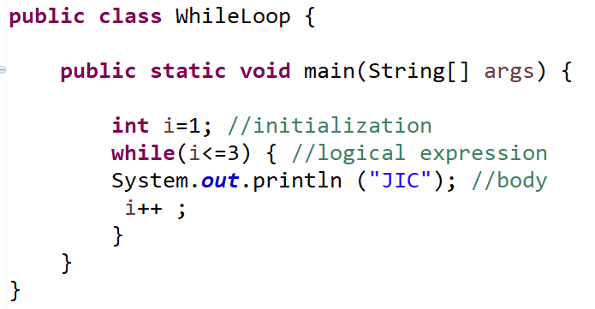
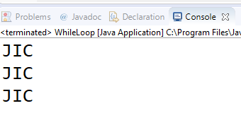
1.While Loop Statement
A Program to demonstrate while loop statement

Slide 8
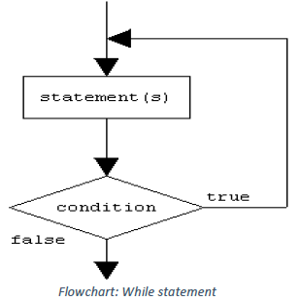
2. do - while loop
In do-while loop statement, first the control executes the statements then it checks for the condition. The statements are executed repeatedly as long as a given condition is true.
Syntax
do {
Statement(s);
} while(condition);

Slide 9
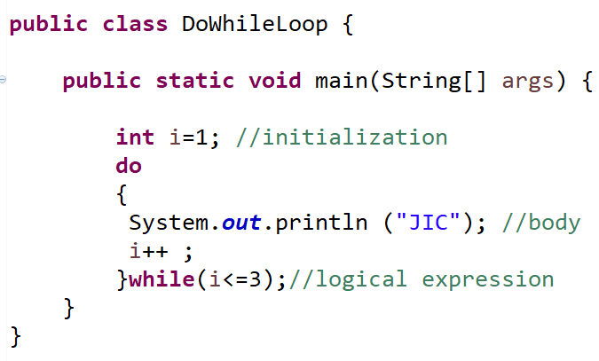
2. do - while loop
A Program to demonstrate do-while loop statement

Slide 10
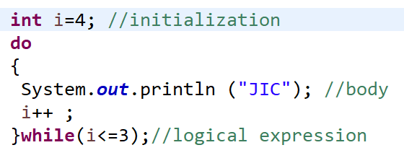
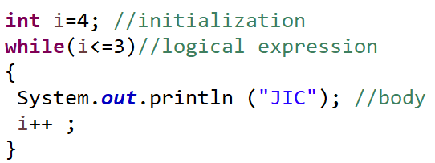
Difference between do while and while statements
While loop is executed only when given condition is true. Whereas, do-while loop is executed for first time irrespective of the condition. After executing while loop for first time, then condition is checked.

Slide 11
3. For loop statement
It also repeat a statement or compound statements for a specified number of times. The for loop executes as follows.
The initialization executes only once.(e.g. int i=1)
The condition is evaluated, if it's true.
a. Executes the statement(s)- body of the loop.
b. Execute the change expression (either increment or decrement).
Repeat step ‘2' until the loop condition evaluates to true.
If the condition false, exit the loop and go to next statement

Slide 12
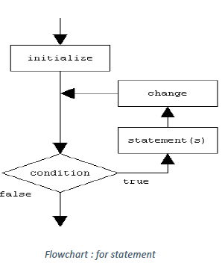
3. For loop statement
Syntax
for (initialization; condition; updation) {
statement(s); //loop body
}

Slide 13
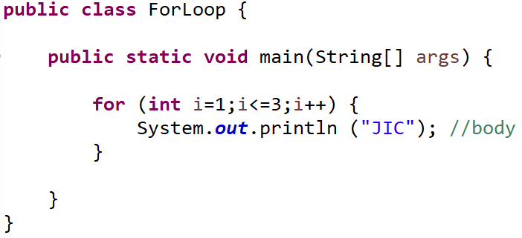
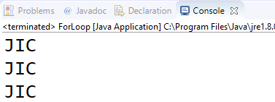
3. For loop statement
A program to demonstrate for loop statement

Slide 14
Keywords : break and continue
1. The break keyword is used for two purposes.
a. To exit early from a loop.
b. To skip the remainder of the switch structure.
2. The continue keyword used in loop statements
It skips the remaining statements in the loop and proceeds with the next iteration of the loop.

Slide 15
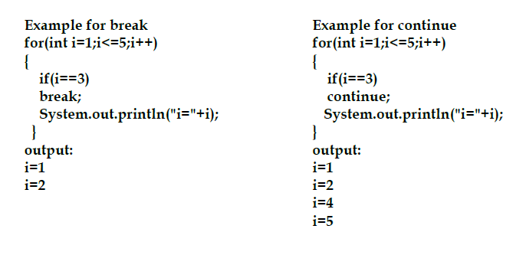
Keywords : break and continue
Differences

Slide 16
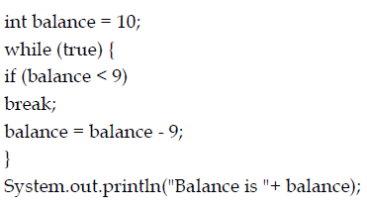
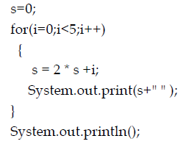
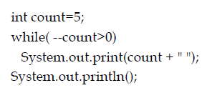
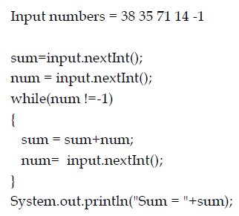
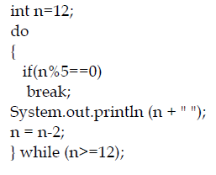
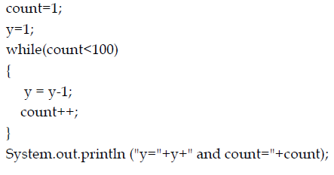
Exercises - Task
What is the output of the following programs segments? (assume all variables declared properly)

Slide 17
Algorithms & tasks
//Programs 6.1: Write a java program to read 3 course marks using for loop and print the total.
Algorithm
Create a class name TotalMarks.
Declare necessary variables.
c) Read 3 course marks using for loop as follows.
Set counter from 1 to 3.
read the marks from the console using Scanner Object until the condition is true.
add these marks to totalmarks variable.
d) Print totalmarks.

Slide 18
Algorithms & tasks
//Programs 6.2: Write a java program to print even and odd numbers up to 20.
Algorithm
Create a class name EvenOdd.
Use for loop as follows
set the counter 1 to 20
In loop body, divide the number by 2 using modulus (%) operator,
if the remainder is equal to zero.
Then print the number as even.
Otherwise as odd number.
e) Close the loop

Slide 19
Algorithms & tasks
//Programs 6.3
Write a java program to print how many times the number 5 is repeated for a given array of inputs.
A program must terminate if input number entered is -1.
For example input is: 2, 5, 13, 5, 15, 18, 55, 95, 5, 56 -1.
Output: The number 5 is repeated 3 times.

Slide 20
Algorithms & tasks
//Programs 6.4 Write a java program to count the number of positive and negative numbers for a series of inputs entered by user using scanner object through console.
A program must terminate if input number entered is zero.
Also compute total numbers entered.
Here is a sample run:
Enter an integer, the input ends if it is 0 : 1 2 -1 3 -2 0
The number of positives : 3
The number of negatives : 2
total : 5

Slide 21
Algorithms & tasks
//Programs 6.5 Write a java program to find and print the largest number from series of input numbers entered using scanner object.
Here is a sample run:
Enter an integer, the input ends if it is 0 : 23 45 78 31 19 44 0
Largest number is : 78

Slide 22
Algorithms & tasks
// Program 6.6: (Find the highest score)
Write a program that prompts the user to enter the number of students and each student’s name and score, and finally displays the name of the student with the highest score.

Slide 23
Algorithms & tasks
Program 6.7: (vote Eligibility)
Using do –whole loop, write a java program to print whether a person is eligible to vote or not. (prompt person’s age)
To vote a person age must be minimum 21 years and above.
The program must run as long as user wish to continue by entering yes or y text or character.

Slide 24
Good luck

