Slide 1
control structures - I Chapter – 05

Slide 2
TOPICS
Definition
Selection control statements
Example programs
Exercises & Tasks
Random numbers

Slide 3
Definition
Control structures allow a programmer to control the flow of execution.
Selection/Decision/conditional control structure. (chapter -05)
Repetition/Loop control structure. (chapter -06)

Slide 4
Selection control structure
In selection control structure, statements are executed based on conditions.
There are four different types of selection control structures.
1. if – statement
2. if-else statement
3. nested if-else statement
4. switch case statement

Slide 5
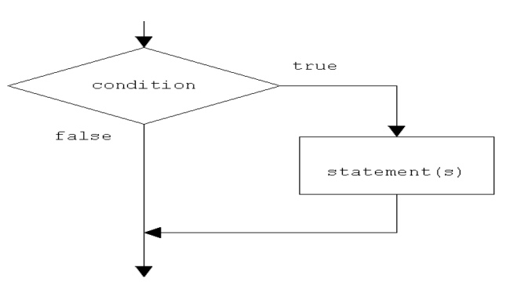
Selection control structure
1. if – statement:
It is one-way selection control statement, the statements are executed if and only if the condition is true.

Slide 6
Selection control structure
1. if – statement
Program 4.1: A java program to demonstrate if statement.
class SimpleIf {
public static void main (String args []) {
int score=76;
if (score >= 60)
System.out.println ("You passed the exam");
}
}
Program 4.2: Write a java program to swap two numbers if first number is smaller than second.

Slide 7
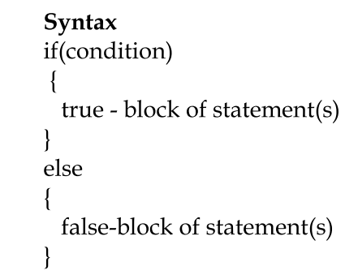
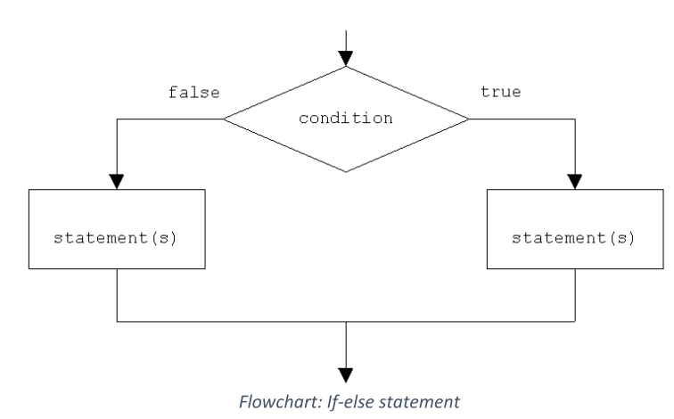
Selection control structure
2. if – else statement: It is a two-way selection control structure. Here, if the condition is true, executes the true block of statements else executes the false block of statements.
Else block must follow if block

Slide 8
Selection control structure
2. if – else statement:
Program 4.3: Write a java program to demonstrate if-else statement.
class IfElse {
public static void main (String args []) {
int score=59;
if (score >= 60)
System.out.println ("You passed the Test");
else
System.out.println ("You Failed in the Test");
}
}

Slide 9
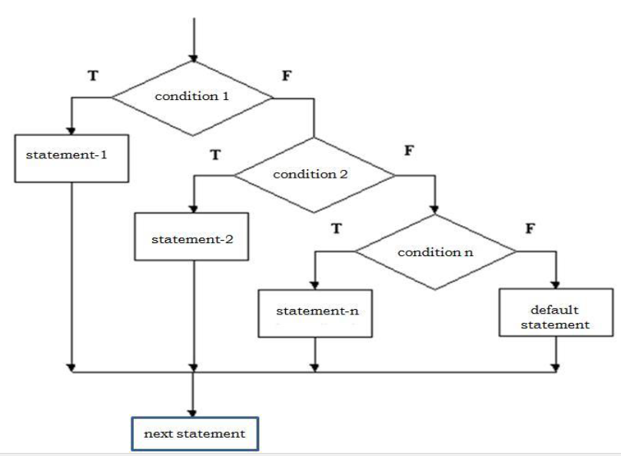
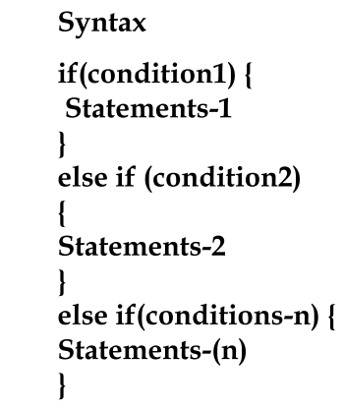
Selection control structure
3. Nested if –else statements: The if-else statement is placed within another if else statement such methods are called nested if-else statements.

Slide 10
Selection control structure
3. Nested if –else statements:
Program 4.4: Write a java program to demonstrate nested if - else statements.
class NestedIfElse {
public static void main(String[] args) {
int day=3;
if(day==1)
System.out.println ("Sunday");
else if(day==2)
System.out.println (" Monday");
else if(day==3)
System.out.println ("Tuesday")
else if(day==4)
System.out.println (" Wednesday");
else if(day==5)
System.out.println ("Thursday")
}
}

Slide 11
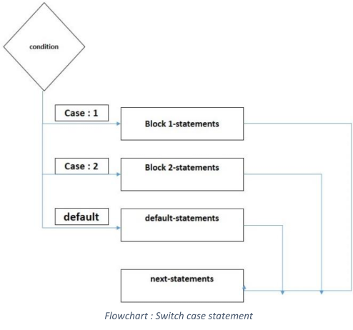
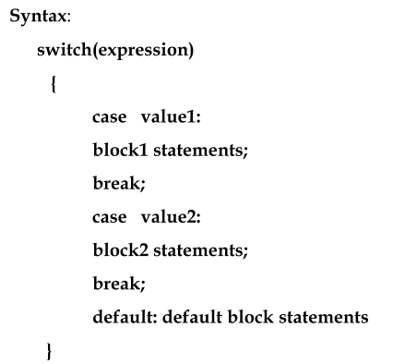
Selection control structure
4. Switch case statement:
The switch statement allows selection among the multiple section of a code depending on the value of an expression. The value must be either integer or character or String type only.
Absence of break will execute the subsequent cases.

Slide 12
Selection control structure
4. Switch statement
Program 4.5: Re-write the Nested If else program 4.4 using switch case statement.
import java.util.Scanner;
class SwitchExample {
public static void main(String args[]) {
int choice;
Scanner input = new Scanner(System.in);
System.out.println("Enter your choice");
choice= input.nextInt();
switch(choice) {
case 1:
System.out.println ("Sunday");
break;
case 2:
System.out.println ("Monday");
break;
case 3:
System.out.println ("Tuesday");
break;
case 4:
System.out.println ("Wednesday");
break;
case 5:
System.out.println ("Thursday");
break;
default:
System.out.println ("enter 1 to 5 only");
}
}
}

Slide 13
exercises
1. Suppose that x , y and z are int variables and x=10, y=15 and z=20.
Determine whether the following expression evaluates to true or false.
i. !(x > 10) →
ii. (x <= 5 || y < 15 ) →
iii. (x != 5) && ( y != z) →
iv.(( x >= z) || (x+y >= z)) →
v. ((x <= y-2) &&(y >= 2))||(z-2 != 20) →

Slide 14
exercises
2. What is the output of the following java code.? Suppose n = 5.
if(n>5)
System.out.println(n);
n=0;
else
System.out.println("number is zero");
Output →

Slide 15
exercises
3. Choose the correct answer
if(6 > 2 * 5)
System.out.println("Hello");
System.out.println("There");
a. Hello There b. Hello c. Hello d. There
There

Slide 16
exercises
4. What is the output o f the program code below
if(7 <= 7)
System.out.println(6 – 9 * 2 /6);
a. -1
b. 3
c. 3.0
d. None of these.
output →

Slide 17
exercises
5. Rewrite the following ternary expression using if…else statement.
(Assume all variables are declared properly.)
a. (x<5) ? y=10: y =20;
b. (fuel>=10) ? drive=150: drive=30;

Slide 18
exercises
6. Correct the following code and if score value is 60 write the output.
if (score>=60);
System.out.println(“fail.");
else;
System.out.print(“pass.");
Output →

Slide 19
exercises
7. Write the output for the following.
a. What is the output if x = 3 and y = 4? →
b. What is the output if x = 2 and y= 2? →
if (x > 2) {
if (y > 2) {
z = x + y;
System.out.println ("z is" + z);
}
}
else
System.out.println ("x is" + x);

Slide 20
exercises
8. What is the output of the following java code if the value of digit is 11?
switch (digit/4) {
case 0:
case 1:
System.out.println ("Low.");
break;
case 2:
case 3:
System.out.println("Middle.");
case 4:
System.out.println("high.");
}

Slide 21
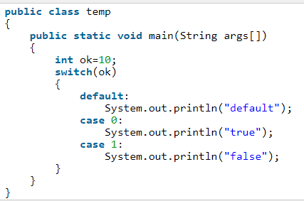
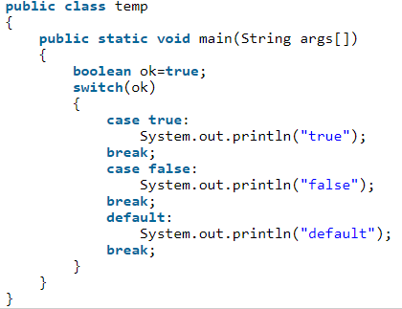
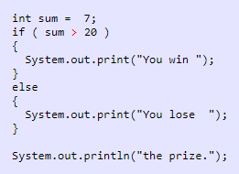
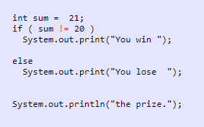
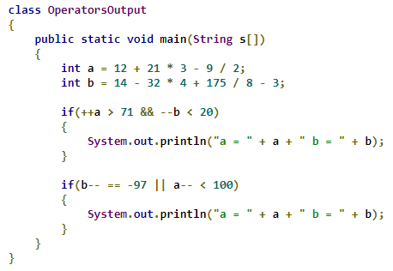
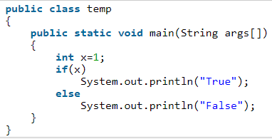
Practice

Slide 22
tasks
Programs 4.6: write a java program that prompts (read) the user to input a
number. The program should then output the message saying whether the
number is positive, negative or zero.
Algorithm
a) Create a class Number.
b) Read any number from the console using scanner class.
c) If the number is greater than zero then print the number is positive.
d) If the number is less than zero then print the number is negative.
e) If the number is equal to zero then print the number is zero.

Slide 23
tasks
Program 4.7: Write a java program that prompts the user to enter an integer. If the number is a multiple of 5, the program displays HiFive. If the number is divisible by 2, it displays HiEven.
Program 4.8: Write a java program to check whether the given number is divisible by 2 and 3.

Slide 24
tasks
Program 4.9: Write a java program that reads three numbers from the user
and print the largest number.
Algorithm
Create a class Largest.
b) Read three numbers (first, second and third) from the console use scanner class object.
c) If first number is greater than second and third, then first number is the
largest.
d) If second number is greater than first and third, then second number is
the largest.
e) If third number is greater than first and second, then third number is
the largest.

Slide 25
tasks
4.10 Write a java program to print student grade of the course as follows
Algorithm
Create a class StudentGrade
Read total marks using scanner object method.
Print the student grade based on the following table data given
If the total marks below zero or more than 100 then program must print a message to re-enter the total mark with appropriate message.
Total marks | Grade
Less than 60 | F
Between 60 to 64 | D
Between 65 to 69 | D+
Between 70 to 74 | C
Between 75 to 79 | C+
Total marks | Grade
Between 80 to 84 | B
Between 85 to 89 | B+
Between 90 to 94 | A
Between 95 to 100 | A+

Slide 26
tasks
Program 4.11: Write a java program to create simple calculator that reads two
numbers and one arithmetic operator(+,-, * and /) to be performed. It
should the output the numbers, the operator, and the result as follows. (using nested if-else)
5 + 4 = 9
15 * 2 = 30
Program 4.12 : Re - write the above program 4.11 using switch case statement, the choice (expression) must be an arithmetic operator.

Slide 27
Random Numbers
You can use Math.random () to obtain a random double value between 0.0 and 1.0, excluding 1.0.
Invoking this method returns a random double value
d such that 0.0 <= number < 1.0.
Thus, (int)(Math.random() * 10) returns a random single-digit integer (i.e., a number between 0 and 9).

Slide 28
Random Numbers
Task
Suppose you want to develop a program for a first-grader to practice subtraction.
The program randomly generates two single-digit integers, number1 and number2, with number1 >= number2, and it displays to the student a question such as “What is 9 - 2?”.
After the student enters the answer, the program displays a message indicating whether it is correct.

Slide 29
Random Numbers
Algorithm
Generate two single-digit integers into number1 and number2.
If number1 < number2, swap number1 with number2.
Prompt the student to answer, "What is number1 – number2?"
Check the student’s answer and display whether the answer is correct.

Slide 30
Good luck

