Slide 1
JAVA OPERATORS Chapter – 04

Slide 2
TOPICS
Java Operators
Expression
Type casting
Types of Java operators
Input & output Statements

Slide 3
Java Operators
Operator is the symbol that performs a specific operation between the operands.
An operand may be a variable or constant.
Combination of these operands and operators becomes an expression.

Slide 4
Java Operators
Arithmetic Operators
Increment/Decrement operators
Relational operators
Logical operators
Conditional Operator
Assignment Operator

Slide 5
1. Arithmetic operators
Arithmetic Operators: It is a binary operator which takes two operands.
Operator | Expression | Meaning
+ | 5 + 3 = 8 | Addition
- | 5-3 = 2 | Subtraction
* | 5*3 = 15 | Multiplication
/ | 5/3 =1 (quotient) | Division
% | 5%3 = 2 (remainder) | Modulus

Slide 6
Arithmetic operators
Program 4.1: A java program to demonstrate arithmetic operators.
class Arithmetic
{
public static void main(String args[])
{
int a=5,b=3,sum,sub,mul,div,mod;
sum=a+b;
sub=a-b;
mul=a*b;
div=a/b;
mod=a%b;
System.out.println(“Addition=”+sum); //8
System.out.println(“Subtraction=”+sub); //2
System.out.println(“Multliplication=”+mul); //15
System.out.println(“Division=”+div); //1
System.out.println(“Modulus=”+mod); //2
}
}

Slide 7
Arithmetic operators
Mixed Expression
An expression that has operands of different data types is called mixed expression.
A mixed expression contains both integer and floating-point numbers.
Examples:
2+3.5
5.4 * 3.4 - 2.1 + 18/2

Slide 8
Arithmetic operators
Mixed Expression
Rules:
1. When evaluating an operator in a mixed expression.
If the operator has same types of operands, the operator is evaluated according to the type of the operand. 5+3 →8 (integer)
b. If the operator has both types of operands, (i.e. one integer and another floating). The result will be floating point number. 2.5 +10 →12.5 (floating)
2. The entire expression is evaluated according to the preceding rules. i.e. the division, modulus, multiplications operators are evaluated before the addition and subtractions operators.

Slide 9
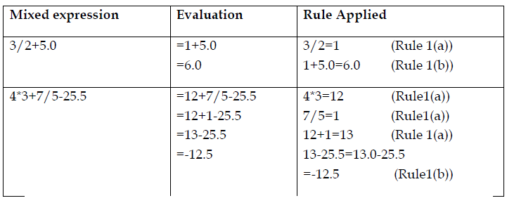
Arithmetic operators
Mixed Expression

Slide 10
Arithmetic operators
Mixed Expression
Program 4.2: A java program to demonstrate mixed expression.
public class MixedExp
{
public static void main(String[] args)
{
System.out.println ("3/2+5.0="+ (3/2+5.0));
System.out.println ("4*3+7/5-25.5="+(4*3+7/5-25.5));
}
}

Slide 11
TYPE CONVERSION (CASTING)
In mixed operands, the integer value is treated as a floating-point value with zero as decimal part.
When the value of one data type is converted another automatically is called implicit type casting.
To avoid implicit casting, java provides for explicit type conversion using cast operator also called type conversion or type casting as follows
Syntax: (dataTypeName) expression
Examples: (int)7.9=7
(double)25=25.0
(double)(15)/2 = 15.0/2(because (double)(15)=15.0)
= 15.0/2.0
= 7.5
(double)(15/2) = (double)(7) (because 15/2=7)
= 7.0
Program 4.3: Write a java program to execute the above type casting examples.

Slide 12
2. Increment & Decrement Operator
It is a unary operator which takes only one operand.
The symbols “++” and “--“are called increment and decrement operator respectively.
The increment operator increased its operand value by one.
The decrement decreased its operand value by one.

Slide 13
2. Increment & Decrement Operator (cont)
There are two types of increment and decrement operators.
a. Pre-increment: An increment operator used before the operand.
syntax: ++variable (i.e. It increments value before it's used)
b. Post–increment: An increment operator used after the operand.
syntax : variable ++ (i.e. It increments value after used)
c. Pre-decrement: A decrement operator used before the operand.
syntax : -- variable (i.e. It decrements value before it's used)
d. Post-Decrement: A decrement operator used after the operand.
syntax : variable -- (i.e. It decrements value after it's used)

Slide 14
2. Increment & Decrement Operator (cont)
Example for post increment:
a =5,
b = 2 + (a++)
Then b = 7 (because a used before increment)
Example for pre increment:
a =5
b = 2 + (++a)
Then b = 8 (because a is used after increment)
Note : similar in decrement operator

Slide 15
2. Increment & Decrement Operator (cont)
Program 4.4: Write a java program to execute the following statements.
a=4 ,b=5;
c=(a++) +b ;
System.out.println(c);
d = (b--)-(++a);
System.out.println(d);
System.out.println(a);
System.out.println(b);

Slide 16
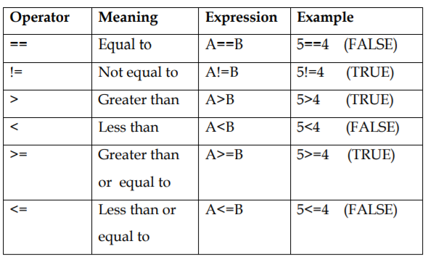
3. Relational Operator
Relational Operators determines the relation between the two operands.

Slide 17
3. Relational Operator
Relational Operators always returns boolean value as a result of expression.
Example
Int a = 5;
Int b = 10;
Int c = 5;
System.out.println(a>b);//false
System.out.println(a<b);//true
System.out.println(a==c);//true
System.out.println(a!=c);//false
System.out.println(c>=a);//true
System.out.println(a<=b);//true

Slide 18
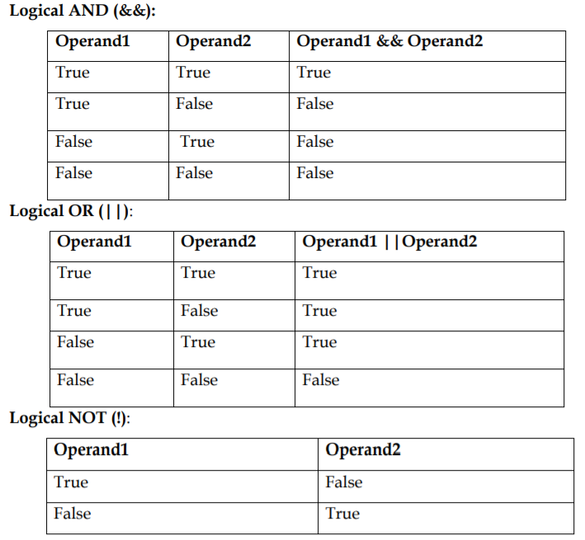
4. Logical Operators
Logical operators are used to check for compound condition, which are formed by the combination of two or more relational expressions.

Slide 19
4. Logical Operators
The result of logical operators in an expression also boolean.
Example
Int a = 5;
Int b = 10;
Int c = 5;
System.out.println(a>b && b>c);//false && true→false
System.out.println(a<b || b<c));//true || false → true
System.out.println(a==c && a>=c);//true && true → true
System.out.println(!(a>b));// !(false) → true

Slide 20
5. Conditional Operator
It is also known as called Ternary Operator (“? :” ) which takes three expressions as follows.
Syntax: Test condition? Expression1: Expression2
Here if the test condition is true then expression1 is evaluated, otherwise expression2 is evaluated.
Example: max= (5>3)? 5: 3;
max = 5 because the condition is true.

Slide 21
INPUT AND OUTPUT STATEMENTS
A java programs is to perform calculations and manipulate data.
So, data must be loaded into main memory before it can be manipulated.
In practical, we put these data into a variable using two ways.
1. Assignment statement.
2. Input (read) statements.

Slide 22
INPUT AND OUTPUT STATEMENTS (cont)
1. Assignment statement
Variable = expression;
c = a + b;
The value of an expression must match the type of the variable.
Thus, the expression on the right hand side is evaluated and assigned to the variable (into a memory) on the left hand side.
In Java, = (the equal sign) is called the assignment operator.
Example: int marks=76;
The value 76 is assigned to the variable 'marks' of integer type.

Slide 23
INPUT AND OUTPUT STATEMENTS (cont)
2. Input (Read) statements
The input statements allows a programmer read the data from the input devices (keyboard) and put into the variables.
Java provides a class called Scanner, which has many methods to read the different types of data from the console (command prompt).
First we need to create an input stream object of Scanner class as follows.
Scanner input = new Scanner (System.in);
Using this 'input', we invoke different methods of Scanner class.

Slide 24
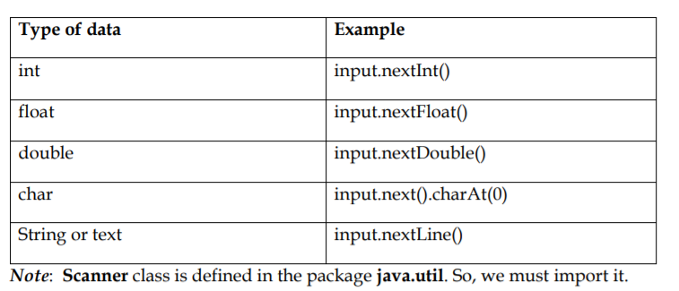
INPUT AND OUTPUT STATEMENTS (cont)
Scanner class methods

Slide 25
OUTPUT STATEMENT
In java, we used System class earlier to print the statements on the output device such as screen.
The System uses standard object to print the statements using the following methods.
System.out.print (expression);
System.out.println (expression);
System.out.println ();

Slide 26
Exercises
1. Write each of the following as a java expression.
32 times a plus b →32*a+b
The character that represents 8 →’8’
The string that represents the line “information technology”
((-b+($b^{2}$-4ac))/2a. → ((-b + (b*b-4*a*c))/(2*a)

Slide 27
Exercises
2. If x = 5, y=6 ,z=4 and w=3.5 , then evaluate each of the following expressions,
(x+z)%y →3
(y%z)%x
((x*y)*w)*z
3. Suppose a =5 and b=6. Then what is the value of each variable after each statement executes?
a) a = (b++)+3
b) c = 2 * a + (++b)
c) b = 2 * (++c) – (a++)

Slide 28
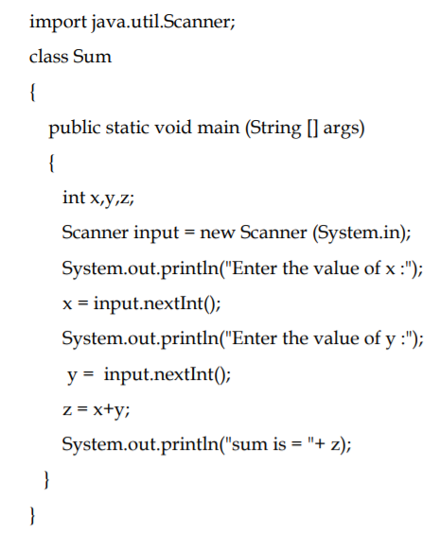
Example Programs
Program 4.5: Write a java program to input (read) two numbers from the console and print the sum.

Slide 29
Example Programs
Program 4.6: Write a java program read student basic details and print it.
Algorithm
a) Create a class Student.
b) Declare variables for student name, id, gpa and grade.
c) Instantiate object of scanner class.
d) Read student name, id, gpa and grade from the console using scanner object.
e) Print name, id, gpa and grade.

Slide 30
Example Programs
Program 4.7: Write a java program to print the total and average of 3 course marks entered from the console.
Algorithm
Create a class MyAverage
Declare three double variables namely m1, m2, m3 for course marks.
Declare two more double data types variables namely total and average to compute total and average marks.
In main method, create an object of Scanner class.
Read three course marks from the console. (Use nextDouble()) method of Scanner class
Add these marks into total variable (e.g. total = m1+m2+m3)
Compute average marks (e.g. average = total/3)
Print Total marks and Average marks.

Slide 31
Example Programs
Program 4.8 : Write a java program that reads input a length in feet and inches then convert into centimeter and print the length in centimeters.
Algorithm
Create a class LengthConversion.
Read the length in feet and inches.
Convert the length into total inches.
total inches = feet * 12 + inches.
d) Convert total inches into centimeters.
centimeters= total inches *2.54
e) Print the length in centimeters.

Slide 32
Example Programs
Program 4.9: Write a java program that inputs number of days and then compute number of years, month's equivalent to number of days.
For example, if the number of days is 690 (input)
Then output is as follows
Years: 1
Months: 10
Days: 25
Note: Assume a year has 365 days and month has 30 days

Slide 33
Example Programs
Program 4.9: Write a java program that inputs number of days and then compute number of years, month's equivalent to number of days.
Algorithm
a) Create a class YMD.
b) Read number of days.
c) Compute number of years. (i.e. years= days/365)
d) Print number of years.
e) Find the remaining days. (i.e. days= days%365).
f) Compute number of months from remaining days. (Months=days/30).
g) Print number of months.
h) Find the remaining days (i.e. days= days%30)
i) Print remaining number of days.

Slide 34
Tasks
Program 4.10: Write a java program to prompt user to input seconds and convert into hours and minutes.
Program 4.11: Write a java program to calculate 15% VAT on given purchase amount (example 5200 SAR.)
Program 4.12: Write a program that converts a Fahrenheit degree to Celsius using the formula.
Celsius = (Fahrenheit – 32 )*5/9
Use scanner method to read Fahrenheit temperature

Slide 35
Tasks
Program 4.13 Write a java program to evaluate the following expression and print the output.
(use scanner object methods to read the values from console)
$x= \frac{−b+b^{2}−4ac}{2a}$ → (-b + b*b – 4*a*c)/(2*a)
$p= {x^{3}+2y}/{1.5}+6$ → x*x*x + (2*y/1.5) + 6
3. $r= \frac{2x+3y+4z}{n^{2}}$ → (2*x + 3*y + 4*z)/(n*n)

Slide 36
Tasks
Program 4.14 Write a java program to convert weight from pound (lb) to weight in kilogram (kg) using the given formula.
(use scanner object methods to read the values from console)
Weight (kg) = weight (lb)/ 2.2

Slide 37
ANY QUESTIONS

