Slide 1
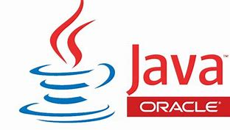
BASIC ELEMENTS OF JAVA
Chapter - 03

Slide 2
TOpics
Java Tokens, keywords and Identifiers.
Data Types
Variables
String class
Example programs & Tasks

Slide 3
JAVA TOKENS
Tokens are the smallest individual units in the program.
Keywords, identifiers, constants, operators etc.., are examples of tokens

Slide 4
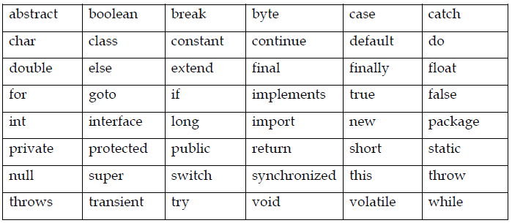
KEYWORDS
The keywords or reserved words which has special and predefined meaning known to the java compiler.
These words cannot be used as names for a variable, constants, class or method.

Slide 5
IDENTIFIERS
These tokens are used for names of things, such as variables, classname, constants and methods that appears in program.
An identifier consists of letters, digits, underscore and dollar sign and must begin with letter or underscore (_) or the dollar ($) sign.

Slide 6
DATA TYPES
Data types are used to specify the type of data that a variable hold. It is classified into two types.
1. Primitive Data types: It is also called standard intrinsic or built-in data type. These can be classified further into four groups:
i. Integers (byte, short, int, long): It deals with integers, or numbers without a decimal part. i.e. 2334, 653,-454,-34
ii. Floating point or real numbers (float, double): It deals decimals with points. i.e. 454.34, 976.66776, -56.88, 3.333 , 0.123, 1.0,0.0
iii. Characters (char): This data type is to represent a single character.
i.e. 'a','1','$', ‘ ’ ,'+‘ , ‘f’, ‘e’, ‘r’ , ‘o’ , ‘z’
iv. Boolean (boolean): This data type represents state of the identifier value either true or false.

Slide 7
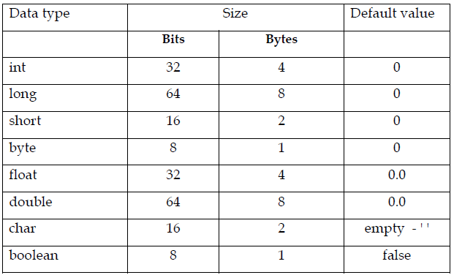
DATA TYPES
Primitive Data types

Slide 8
DATA TYPES
2. Non Primitive Data types: Data Types or Abstract Data Type or Reference Type.
These are built on primitive data types such as
String
System
Scanner

Slide 9
VARIABLE
It is a quantity which can be changed during the program execution which holds some value.
e.g. price→ 30.45 (value)
Variables are identifiers are which follows Java rules.
1. Variable name must begin with a letter, or a dollar ($) symbol, or an underscore (_) followed by a sequence of letters.
Examples: first, payRate, counter1, $amount, _hello12
2. Variable names must be unique. (no duplicate of identifier)
3. There should be no space in between any two characters or identifiers.
Example: pay Rate is invalid. Whereas payRate is valid
4. Keywords cannot be used for variable name.
5. Java is a case sensitive, so upper and lower letters are distinct.(different)
Example ‘A’ is not same as ‘a’
6. Variable must be declared before it is used.

Slide 10
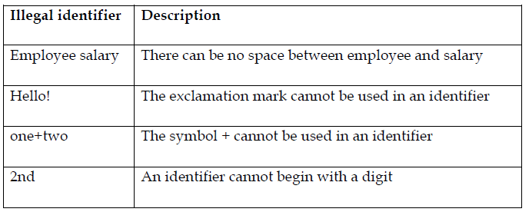
VARIABLE
Illegal Variables

Slide 11
1.Declaration of variables
All variables must be declared before they can be used .
The basic form of a variable declaration is
Example:
int studentID;
double price;
char grade;
String name;
boolean status;
Syntax: data-type variable_name;

Slide 12
1.Declaration of variables
We can declared more than one variables of same type as follows.
Example : int x;
int y;
int z;
As in a single line
Example: int x, y, z;
Syntax: data – type identifier 1, identifier 2….identifier n;

Slide 13
2.Initialization of variable
Variable is initialized with equal sign and a value.
Example:
int studentID = 401905523;
double price = 32.50;
char grade =‘B';
String name = “Feroz Mohammed”;
boolean status = true;
Syntax: data-type variable_name = value;

Slide 14
STRING
String is a sequence of zero of more characters enclosed in double quotes.
In java String is a class which has various operations to manipulate a string.
A string that contains no characters called null or empty string.
Examples:
"Hello"
"Welcome to MIT"
" " Empty string
“3453465gndfjkgnk0-86&#$$#@*)(”
“123”

Slide 15
String concatenation operator (+)
The most common operation performed on strings is the concatenation operator, which appends one string to another string, numeric value or character.
Example: "Hello," + "Feroz" → Hello, Feroz
Amount Due =“$" + 568.69 →$568.69
For above statements the numeric value is converted to string and concatenated with the string as - Amount Due = $568.69

Slide 16
Exercises
1. Which of the following are valid java identifier?
myProgram
_myprgm
$23First
12$Second
FiirST_TWO
Update Grade
5Th
JAVA_FIZ_$
2.Which of the following are not reserved words
a) char b) int c)float d)large e)double f)bit

Slide 17
EXERCISE program
3.1. Correct the following program and execute it.
public class Find Errors {
public void main(String[] args) {
String text="Finding Errors"
char c ='C+';
int a = 10;
int b = 5.20;
double a;
Total Value = a + b*a;
boolean short = true
System.out.println(text);
System.out.print(" “ Total Value);
}

Slide 18
EXERCISE program
3.2 Write a java program to add two numbers and print the result.
Algorithm
Step-1 : Declare two variables num1 and num2 and initialize to any values.
Step- 2: Declare another variable total.
Step-3 : Add two numbers and assign the result to total as
total = num1 + num2
Step-4: Print the total value as a result.

Slide 19
Exercise Program
3.3 Write a java program to compute area of rectangle using given formula below
Area = length * width
Algorithm
Step-1 : Declare variables length and width with any initial values
Step -2 : Declare result variable area.
Step-3 : use above formula to compute area
Step-4 : Print area value.

Slide 20
Tasks
3.4 Write a java program to convert Fahrenheit temperature to Celsius degree using the equation.
$$c=\frac{\left(f−32\right)∗5}{9}$$
Note : The initial value of f = 98.4
3.5 Write a java program to calculate the area of circle using the equation
Area $=πr^{2}$ (where $π$ = 3.14) – (PI)
Note : The initial value of r = 5.20
3.6 Write a java program to compute the average of three numbers 10.0, 20.5 and 30.6.
3.7 Write a java code to convert time in minutes & hours from given seconds and display it.
Note : Assume given seconds is 4500

