Slide 1
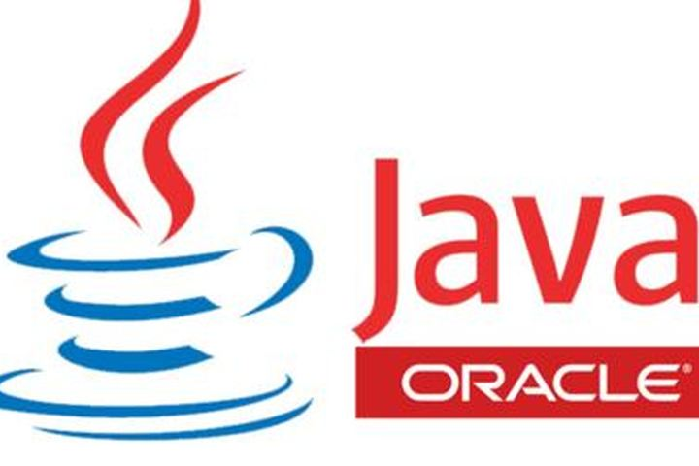
Introduction to Java Concepts and Algorithm
Chapter - 02

Slide 2
Topics
Introduction to java
Java features
Java Terminologies
Java Principles
Algorithm
Download JDK and Eclipse
First java program using eclipse.

Slide 3
Introduction to Java
Java is a high level programming language was originally developed by James Gosling at Sun Microsystems (now acquired by Oracle Corporation) and released in 1995 as a core component of Sun Microsystems' Java platform.
Java follows Object-oriented programming paradigm based on the concept of "objects", which may contain data, often known as attributes; and code, often known as methods.
Everything in java is objects and it utilizes class concept on which object is the most fundamental part.

Slide 4
Java Editions
Java is a full-fledged and powerful language that can be used in many ways. It comes in three editions:
Java Standard Edition (Java SE) to develop client-side applications. The latest version of Java is JAVA SE 15.
Java Enterprise Edition (Java EE) to develop server-side applications.
Java Micro Edition (Java ME) to develop applications for mobile devices.

Slide 5
JAVA TERMINOLOGIES
Java Development Kit (JDK): It is complete java development kit that includes JRE (Java Runtime Environment), compilers and various tools like JavaDoc, Java debugger etc.
In order to create, compile and run Java program you would need JDK installed on your computer.

Slide 6
JAVA TERMINOLOGIES (Continued.)
Java Runtime Environment (JRE): JRE is a part of JDK which means that JDK includes JRE.
When you have JRE installed on your system, you can run a java program however you won’t be able to compile it.
JRE includes JVM (Java Virtual machine), browser plugins and applets support. When you only need to run a java program on your computer, you would only need JRE.

Slide 7
JAVA TERMINOLOGIES (Continued.)
Java Compiler (javac): A java compiler is a program that translates a java program into byte code. Compiler always checks syntax errors and semantic errors in the program. It generates byte code after successful compilation.
Byte Code: Java compiler of JDK compiles the java source code into byte code so that it can be executed by JVM. The byte code is saved in a .class file by compiler.

Slide 8
JAVA TERMINOLOGIES (Continued.)
Java Virtual Machine (JVM): JVM executes the byte code generated by compiler. This is called program run phase.
Interpreter (java): A Java interpreter is a software that translates the Java byte code into the code that can be understood by the Operating System. Interpreter implements Java virtual machine (JVM) which runs java applications.

Slide 9
JAVA TERMINOLOGIES (Continued.)

Slide 10
FEATURES OF JAVA
Simple: Java language is simple because its syntax is based on C and C++.
Object-oriented: we organize our software as a combination of different types of objects that incorporates both data and behavior. (methods)
Platform Independent: The programs written on one platform can run on any platform. A platform is the hardware or software environment in which a program runs.
Security: Java is secured because:
o No explicit pointer.
o Programs run inside virtual machine sandbox.

Slide 11
FEATURES OF JAVA (Continued.)
Robust: Java programs are more reliable since its uses memory management, Automatic garbage collection, Exception Handling, Type checking mechanism.
Portable: The feature Write-once-run-anywhere (WORA) makes the java language portable provided that the system must have interpreter for the JVM.
Dynamic: Java is a dynamic language, is capable on dynamically linking in new class, libraries, methods and objects.
Multi Threading : Java multithreading feature makes it possible to write program that can do many tasks simultaneously.
Distributed : Java is also a distributed language. Programs can be designed to run on computer networks.

Slide 12
PRINCIPLES OF OBJECT-ORIENTED PROGRAMMING
1.Encapsulation: Wrapping of data and functions (methods) into a single class is known as encapsulation.
2. Abstraction: It is the process of defining data types, often called as abstract data type, and functions without any implementation details is knows as Abstraction.(Data hiding).
3. Inheritance: Inheritance is the mechanism that allows the programmer to drive new classes from existing classes. The derived classes inherits the methods & data of the parent class.
4. Polymorphism: Polymorphism is the feature that allows giving a single name to different methods with different parameters.

Slide 13
ALGORITHM
A step-by-step approach to solve a problem with a solution at a given finite amount of time is known as algorithm.
Qualities of a good algorithm
  Input and output should be defined precisely.
  Each step in the algorithm should be clear and unambiguous.
  Algorithms should be most effective among many different ways to solve a problem.
  An algorithm shouldn't include computer code. Instead, the algorithm should be written in such a way that it can be used in different programming languages.

Slide 14
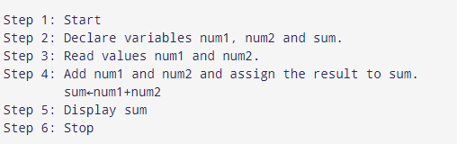
Examples Of Algorithms In Programming
Write an algorithm to add two numbers entered by the user.

Slide 15
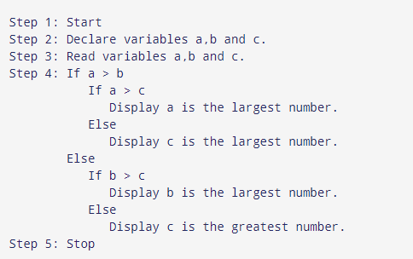
Examples Of Algorithms In Programming(Cont..)
Write an algorithm to find the largest among three different numbers entered by the user.

Slide 16
Examples Of Algorithms In Programming(Cont..)
Write an algorithm to determine whether a student passed the course or not:
Step1 : Start
Step 2: Declare variables m1,m2,m3, total.
Step 3: Read values of m1,m2 and m3.
Step 4 : Add all course assessments m1, m2 and m3 and assign the result to total variable.
  total = m1 + m2 + m3
Step 5: If the total greater than 60, display “PASS", otherwise print “FAIL".
Step 6 : Stop

Slide 17
Exercise 1.1
Design an algorithm to convert the Fahrenheit temperature to Celsius temperature using the formula
C = (F-32) * 5/9.
Where 'C‘ represents Celsius and
'F‘ is Fahrenheit temperature.

Slide 18
Algorithm
Step-1 : Start
Step 2: declare variables C and F
Step -3 : Read F temperature value
Step-4 : Covert to C the formula given
    C = (F-32) * 5/9.
Step-5 : display C temperature
Step -6 : Stop

Slide 19
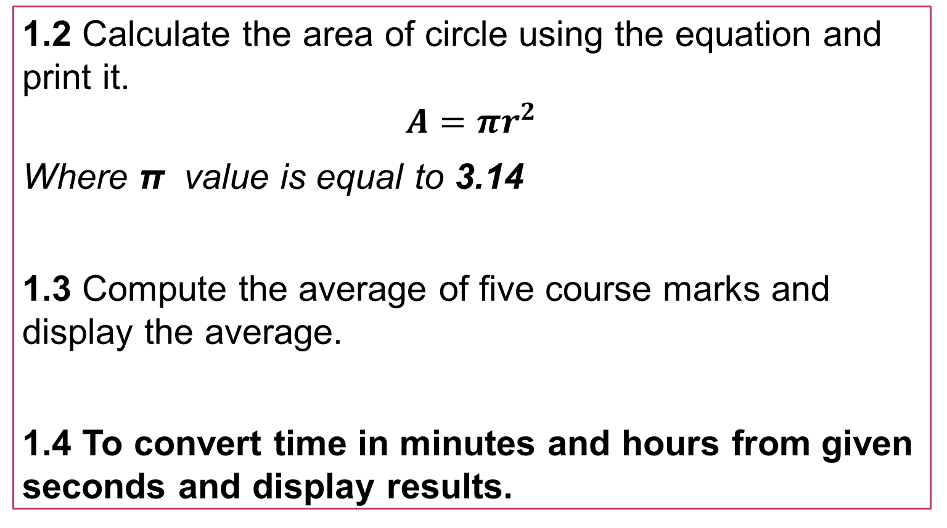
Exercises Problem
Write an algorithm for the following problem
1.2 Calculate the area of circle using the equation and print it.
$$A=πr^{2}$$
Where π value is equal to 3.14
1.3 Compute the average of five course marks and display the average.
1.4 To convert time in minutes and hours from given seconds and display results.

Slide 20
REQUIREMENTS FOR DEVELOPING JAVA PROGRAMS
Java Development Kit (JDK): Installing java development kit consists of supporting libraries, java compiler and Java Virtual Machine (JVM) Interpreter.
Program Editor : Notepad, edit plus, Notepad++ and IDE (Eclipse, Net beans, JCreator, etc)

Slide 21
DOWNLOAD AND INSTALLATION OF JDK AND ECLIPSE SOFTWARE PACKAGE
Download JDK
Click on below link to download latest JDK version for various Operating system (32 bit and 64 bit versions) , preferable JDK 8 or over.
https://www.oracle.com/java/technologies/javase-downloads.html
Or
JDK 8 (64 bit)- for windows
https://www.filehorse.com/download-java-development-kit-64/35913/
JDK 8 (32 bit) for windows
https://www.filehorse.com/download-java-development-kit-32/

Slide 22
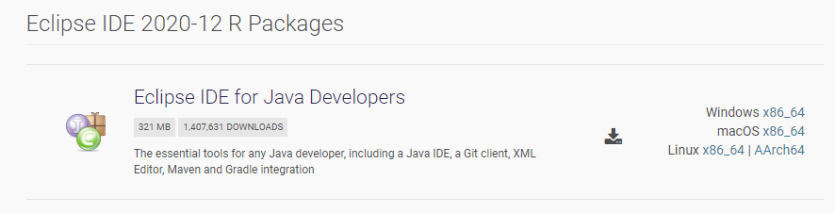
1. Download and Install Eclipse IDE
Click on below link to download latest version of eclipse package compatible for your OS.
https://www.eclipse.org/downloads/packages/

Slide 23
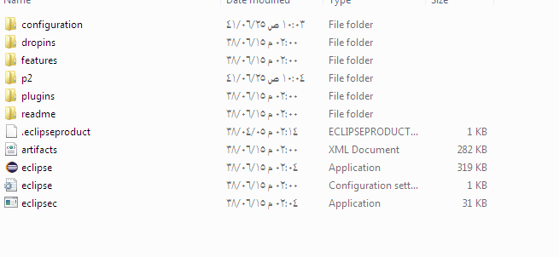
1. Download and Install Eclipse IDE (Cont..)
You will see the package name like this: eclipse-jee-neon-R-win32-x86_64.zip
Extract this ZIP file into a directory on your computer. You will see a directory called eclipse containing Eclipse’s installed files:

Slide 24

1. Download and Install Eclipse IDE (Cont..)
Eclipse Neon requires Java 8 or newer so make sure you have JDK 8 already installed on your computer.
Click eclipse.exe file (Windows) to start the IDE. You will see the splash screen of Eclipse Neon:

Slide 25
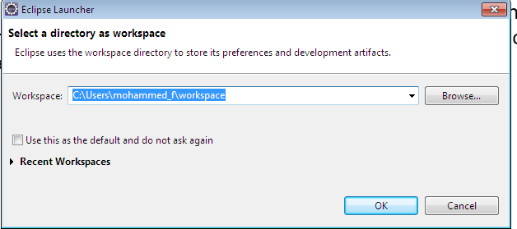
2. Choose a Workspace Directory
Eclipse organizes projects by workspaces. A workspace is a group of related projects and it is actually a directory on your computer. That’s why when you start Eclipse, it asks to choose a workspace location like this:

Slide 26
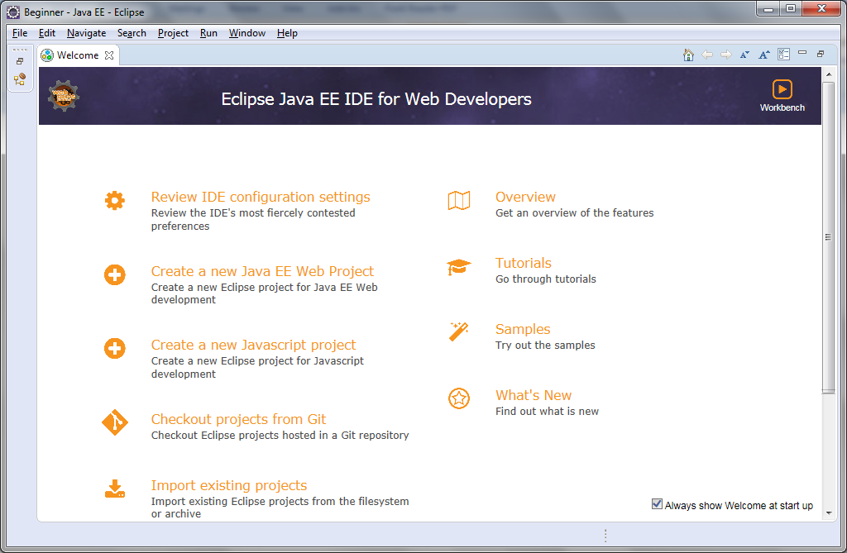
2. Choose a Workspace Directory (Cont..)
Click OK. You should see the welcome screen:
Now, we are ready to create a Java project.

Slide 27
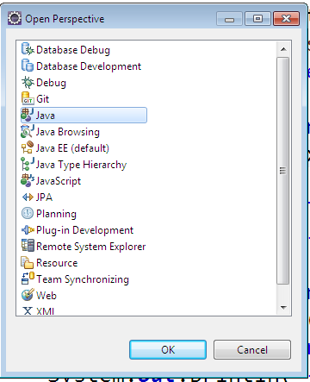
3. Change Perspective
To change perspective, go to Window > Perspective > Open Perspective > Other… You will see a small dialog listing all available perspectives:

Slide 28
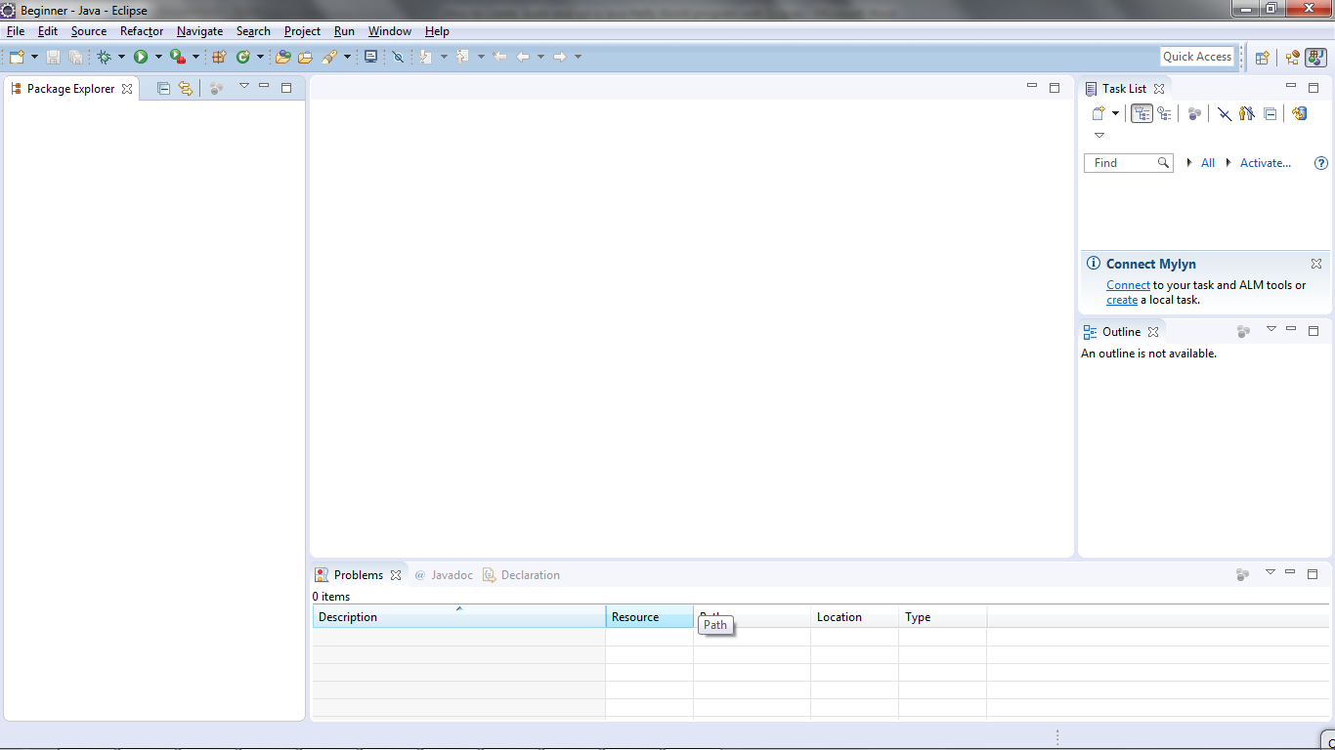
3. Change Perspective (Cont..)
Here we choose Java perspective. Click OK. Here’s how the Java perspective would look like:

Slide 29
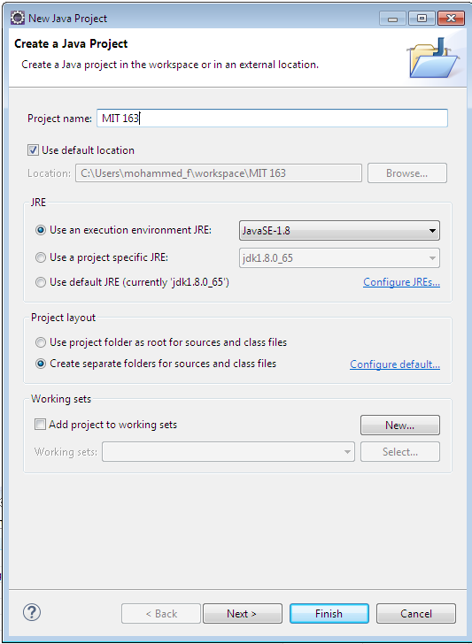
4. Create a Java Project
To create a new Java project in Eclipse, go to File > New > Java Project. The New Java Project wizard dialog appears let you specify configurations for the project:

Slide 30
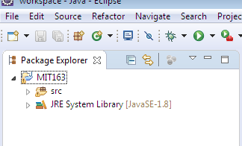
4. Create a Java Project (Cont..)
Enter project name: MIT 163. Leave the rest as it is, and click Finish.
You should see the MIT 163 is created in the Package Explorer view as following:

Slide 31
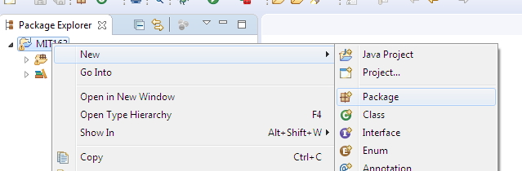
4. Create a Java Project (Cont..)
It’s recommended to create a package for your project. Right click on the project, and select New > Package from the context menu:

Slide 32
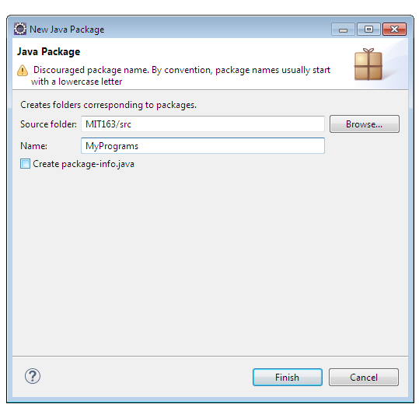
4. Create a Java Project (Cont..)
In the New Java Package dialog, enter the name your package. Here I enter MyPrograms

Slide 33
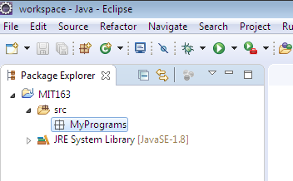
4. Create a Java Project (Cont..)
Click Finish. You should see the newly created package appears:
Now, it’s time to create a Java class for your hello world application.

Slide 34
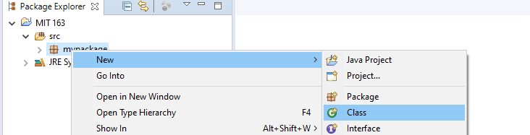
5. Write Your First Java Program
To create a new Java class under a specified package, right click on the package and select New > Class from the context menu:

Slide 35
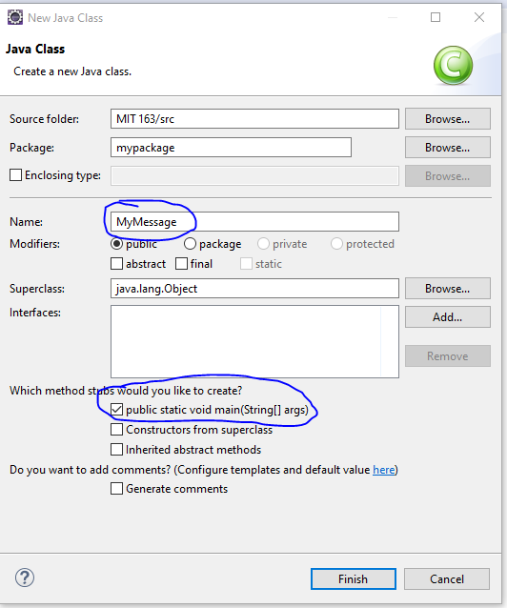
5. Write Your First Java Program
The New Java Class dialog appears, type the name of class as MyMessage and choose the option to generate the main() method:

Slide 36
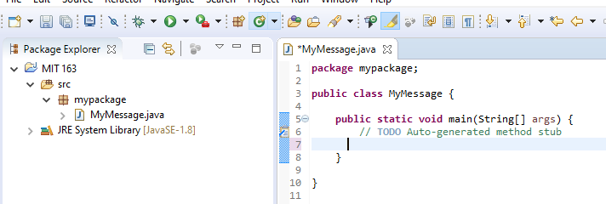
5. Write Your First Java Program (Cont.)
And click Finish. The MyMessage class is generated like this:

Slide 37
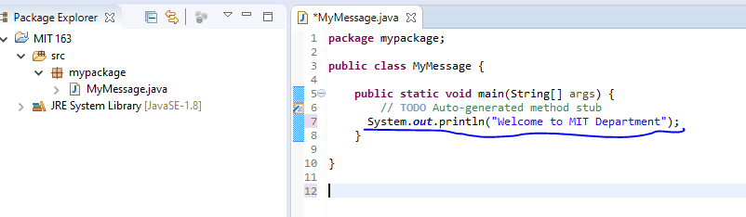
5. Write Your First Java Program (Cont.)
Now, type some code in the main() method to print the message “Welcome to MIT Department” to the console:
That’s it. We have created a Java hello world program using Eclipse IDE.

Slide 38
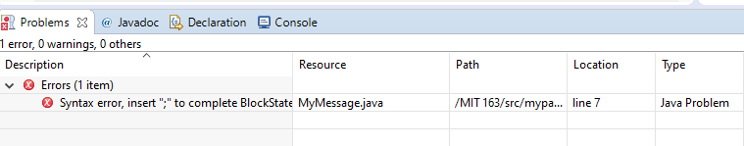
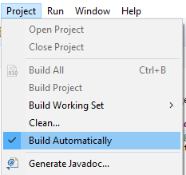
6. Compile, Build and Run Your First Java Program
By default, Eclipse compiles the code automatically as you type. And it will report compile errors in the Problems view at the bottom like this:
If you want to disable automatically build feature, click the menu Project and uncheck Build Automatically:
However, it’s strongly recommended to keep the auto build mode for it helps you detect errors instantly.

Slide 39

6. Compile, Build and Run Your First Java Program (Cont.)
Now, let’s run the hello world application. Click menu Run > Run (or press Ctrl + F11), Eclipse will execute the application and show the output in the Console view:
That’s it! The MyMessage program has run and printed the output “Welcome to MIT department” and terminates.

Slide 40
UNDERSTANDING FIRST JAVA PROGRAM
class keyword is used to declare a class in java.
public keyword is an access modifier which represents visibility, it means it is visible to all.
static is a keyword, if we declare any method as static, it is known as static method. The core advantage of static method is that there is no need to create object to invoke the static method.
void is the return type of the method, it means it doesn't return any value.
main represents startup of the program.
String [] args is used for command line argument of String type.
System.out.println () is used print the statement.

Slide 41
Special Characters
{ } Opening and closing braces denote a block to enclose statements.
() Opening and closing parentheses Used with methods.
[] Opening and closing brackets denote an array.
// Double slashes represents a comment line.
" " Opening and closing quotation marks enclose a string.
; Semicolon Mark the end of a statement.
+ concatenation operator to add two strings.

Slide 42
Difference between println () & print ():
println () prints the string and moved the cursor to new line.
Whereas, print () prints the string but doesn’t move the cursor to the new line.
Output is:
The sum of 2 and 3 is = 5
7 + 8 = 15

Slide 43
Exercise programs
Write a java program to print the message “This is my first java program using eclipse”.
Write a java program to print following two messages
  A. Programming is thinking
  B. Programming is not typing

Slide 44
Comments in Java
Comments are used to describe program only, it will not be executed by compiler.
Three types of comments are available in java.
1) Single line comment (//).
2) Multi line comment (/*and*/).
3) Documentation comment (/**and*/).

Slide 45
GOOD LUCK

