Slide 1
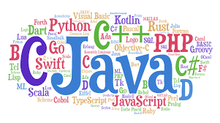
MIT 163 - Programming Concepts
Chapter – 01

Slide 2
Topics
Language
Program
Programming language
Evolution of programming language
Programming approaches
Language translators.

Slide 3
Language
Human Language
Commonly used to express feelings and understand other person expressions.
It can be oral or gestural kind of communication.
Computer Language
Computer languages are the languages by which a user command a computer to work on the algorithm which a user has written to get an output.

Slide 4
Definition of program
A computer program is a series of organized instructions that directs a computer to perform tasks.
(or)
A set of instructions which are executed on computer for specific task is known as program.

Slide 5
Definition of programming language
A programming language is a set of words, symbols and codes that enables humans to communicate with computers.
Programming languages are used to write application programs which are used by end users.
Each computer programming language has its own distinctive grammars and syntax and its own manner of expressing ideas.

Slide 6
Examples of programming languages
Thousands of programming languages exists today.
Examples
Basic
PASCAL
FORTRAN
C++
JAVA
C#
Python

Slide 7
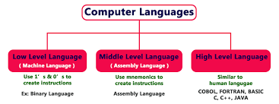
Evolution of programming languages
To build programs, people use languages that are similar to human language.
The results are translated into machine code, which computers understand.
Programming languages fall into three broad categories:

Slide 8
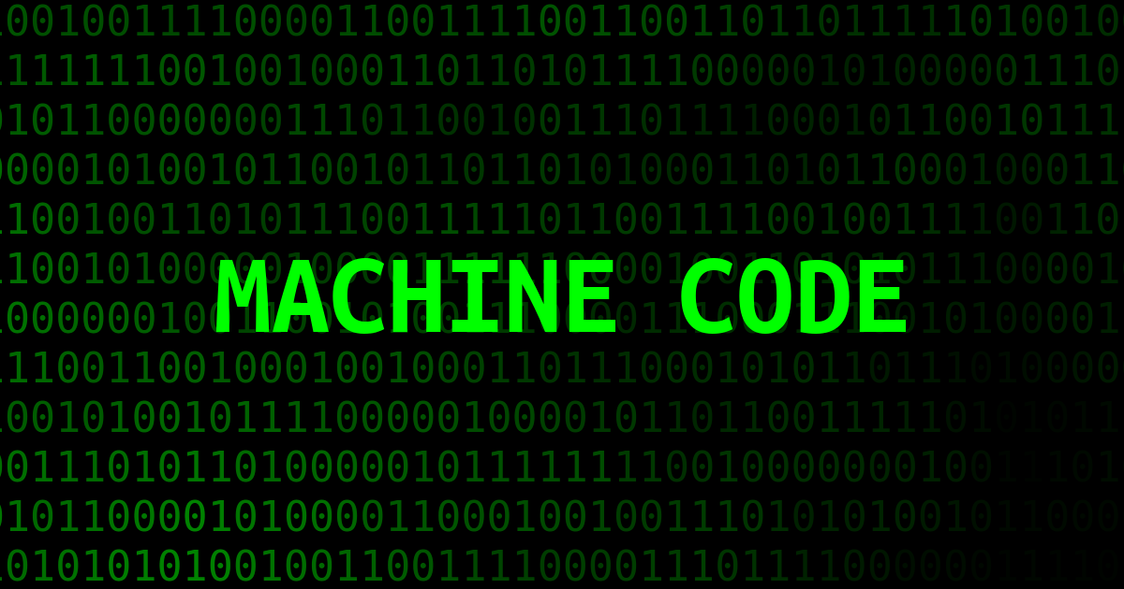
Machine Language
Machine languages (first-generation languages) are the most basic type of computer languages, consisting of strings of numbers the computer's hardware can use.
Different types of hardware use different machine code. For example, IBM computers use different machine language than Apple computers.

Slide 9
Assembly languages
Assembly languages (second-generation languages) are only somewhat easier to work with than machine languages.
To create programs in assembly language, developers use cryptic English-like phrases to represent strings of numbers.
The code is then translated into object code, using a translator called an assembler.

Slide 10
Assembly languages
Machine Code

Slide 11
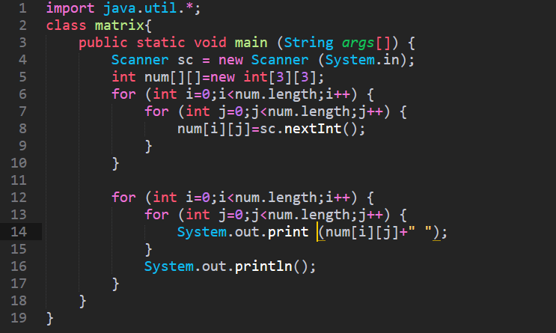
Higher Level Language
Higher-level languages are more powerful than assembly language and allow the programmer to work in a more English-like environment.
Higher-level programming languages are divided into three "generations," each more powerful than the last:
Third-generation languages
Fourth-generation languages
Fifth-generation languages

Slide 12
Programming Language Approaches
Structured Oriented approach.
Object – Oriented approach.

Slide 13
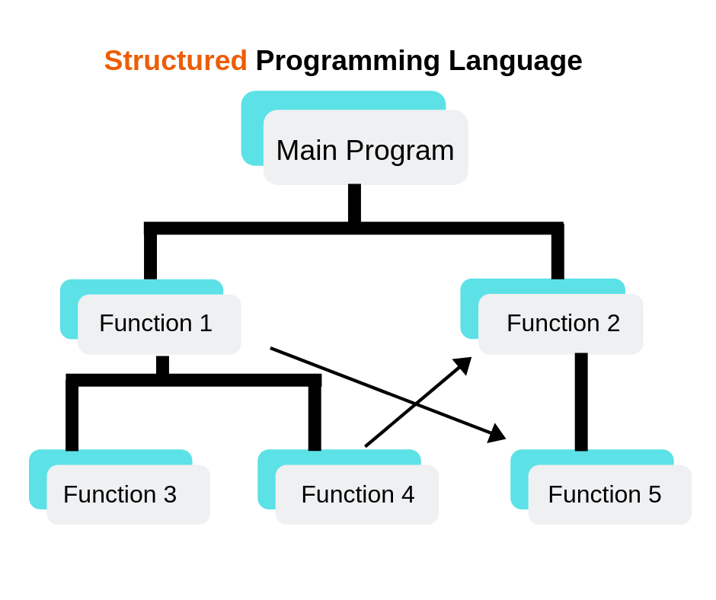
Structured Programming
Structure programming uses top down model where developers map overall program structure into separate subsections (modules) from top to bottom.
Examples of structured programming languages are , PASCAL, FORTRAN, and C.

Slide 14
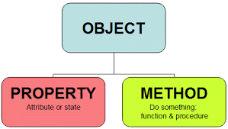
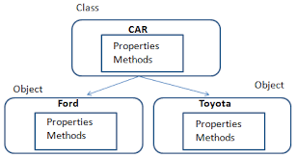
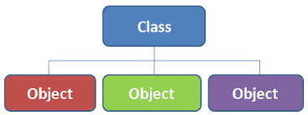
Object – Oriented Programming
The object - oriented approach refers to a special type of programming approach that combines data with functions to create objects.
Examples : - Java, C#, Visual basic and C++.

Slide 15
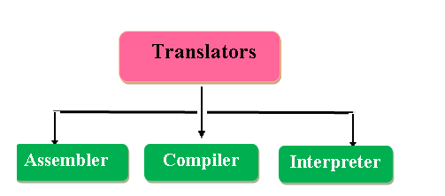
Translators
A translator is a programming language processor that converts a computer program from one language to another.
It takes a program written in source code and converts it into machine code. It discovers and identifies the error during translation.

Slide 16
Translators
1. ASSEMBLER
Assembly language is converted into executable machine code by a utility program referred to as an assembler.
An assembler creates object code by translating assembly language instructions into object codes.
Source code
Assembler
Object code

Slide 17
Translators
2. Compiler
A compiler is a programs that translate source code from a high-level programming language to a lower level language (e.g., assembly language, object code, or machine code) to create an executable program.
Examples of Programming Languages Using compiler :
C
C++
JAVA etc.
Source code
Compiler
machine code

Slide 18
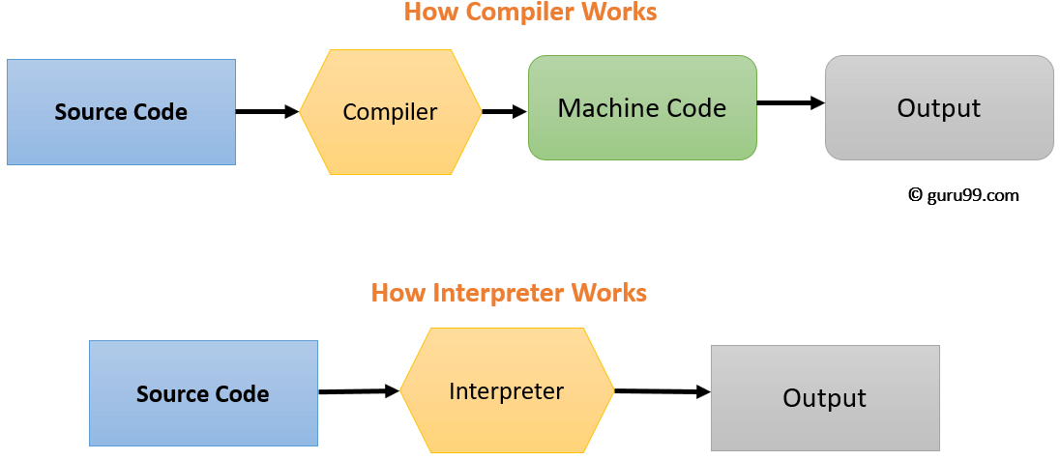
Translators
3. Interpreter
Interpreters translate source code into machine language while a program is running, one line at a time, unlike compiler, which processes everything at once.
In this case a single line is executed at a time. It is time consuming.
Examples of Programming Languages Using Interpreter :
Lisp
BASIC
JAVA

Slide 19
Source Code
Source Code is In the form of Text.
Source Code is Human Readable.
Source Code is Generated by Human.(programmer)
Source Code is Input Given to Compiler.

Slide 20
Object Code
Object Code is in the form of Binary Numbers.
Object Code is in Machine Readable.
Object Code is Generated by Compiler.
Object code is Output of Compiler.

Slide 21
Linker
Linker uses the object files created by the compiler and then uses the predefined library objects to create an executable.

Slide 22
Program Development Cycle
The program development cycle consists of six basic steps to follow when planning a computer program.
By following this step-by-step process, the chance of making mistakes is minimal.
Analyzing
Design
Validation
implementation
Testing
Documentation

Slide 23
Step 1 : Analyzing
Analyzing basically defines the problem. This is a very important step in the process in order to develop an appropriate solution.
At this time, an outline is made which defines the entire process including the program's input, output, and processing components.

Slide 24
Step – 2 : Design
The second step in the cycle is design.
At this time, any problems found during the analysis are broken down.
The method and appropriate programming language are chosen during this process.
Structured design allows the problem to be broken down into sections called modules. This can be done so that each routine performs a single task.
The structured design is important because it turns the main routine into smaller ones which helps the programmers locate any problems easily and stay organized.

Slide 25
Step- 3 : Validating
The third step in the process is validating the design.
This is done by computer programmers who code the design into a programming language.

Slide 26
Step- 4 : Implementation
The fourth step is Implementing the design.
This is when the code to translate the design into a program is written. The new system is installed at this time.

Slide 27
Step -5& 6 : Testing & Documenting
Steps five and six are testing and documenting the solution.
The program is maintained and if any changes are needed, the cycle begins again.
The program development cycle is in fact called a cycle because any phase can lead to the previous or next step in the process.
This normally happens only if an error is found. It is also referred to as a cycle because once it ends it begins again.

Slide 28
Besides the programmer, there are many other people involved in the stages of the program development cycle. System analysts, designers, system architects, coders and testers are also involved in the cycle. They are all important when it comes to developing a successful program.

Slide 29
GOOD LUCK

